Slide 1



CSCI 6409 – Process of Data Science
GROUP 10
False Smoke Alarm Detection
Team Members:
Sai Chinthirla (B00911631)
Raghu Mathukamalli (B00900939)
Chanpreet Singh (B00896766)
Prakrut Suthar (B00885349)
Hemad Fetrati (B00923436)
Instructor: Dr. Evangelos E.Milios

Slide 2


WHY?
Low Battery
Organic Compounds present in Paint
Humid weather
Oil and residue is present in furnaces
Motivation
Better utilization of fire handling resources
Minimization of penalties
https://www.vectorstock.com/royalty-free-vector/false-alarm-rubber-stamp-vector-12479872

Slide 3


Literature Review
Aerial imagery pile burn detection using deep learning with variations in images.
Fast fire flame detection in surveillance video using logistic regression.
VGG19-based transfer learning solution for a forest fire detection system.
Fire detection based on image processing produced poor results.

Slide 4
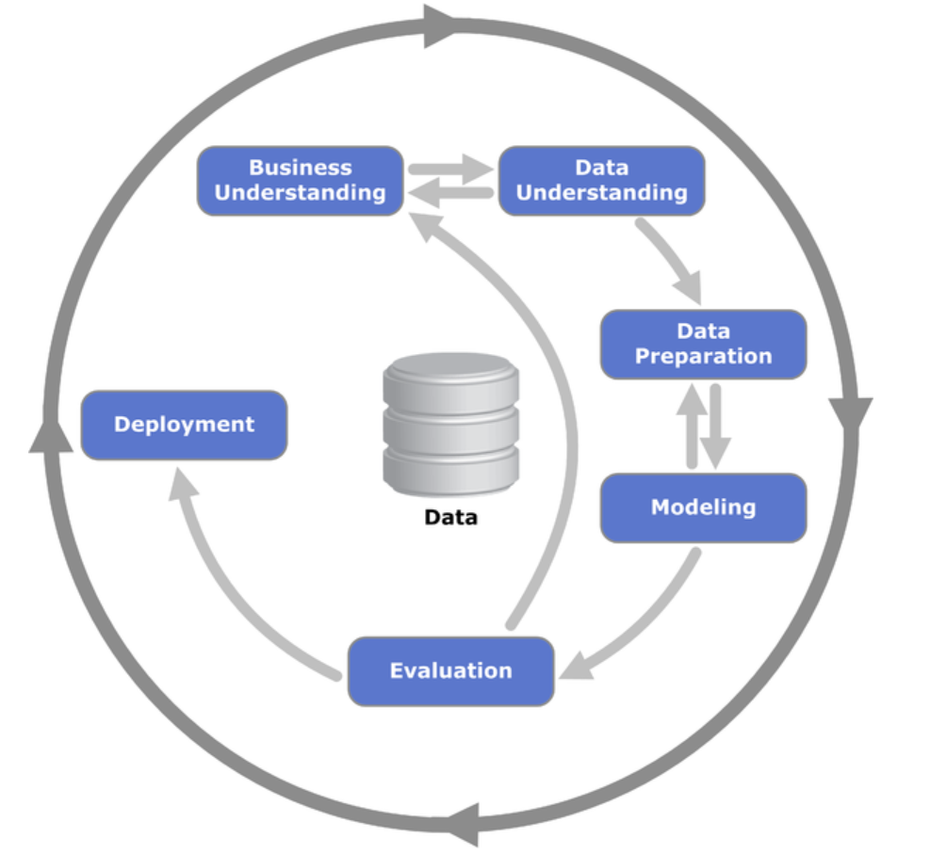
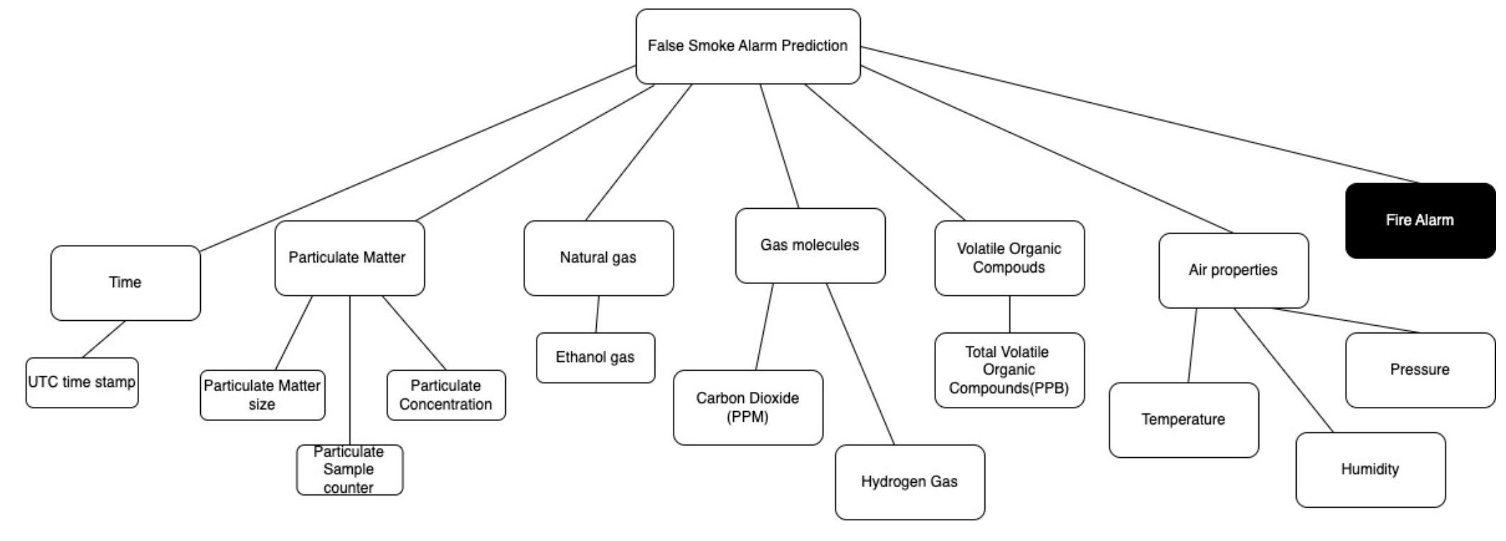
Crisp-DM Methodology
Business Understanding
Minimize the false fire alarms
Fines up to 3500 CAD per single false alarm
Three predictive analytical solutions
Captured data in ABT

Slide 5
Crisp-DM Methodology
Data Understanding:
Data Quality Report
Data Quality Plan
Visualizations, Data quality issues
Data Preparation:
Missing Values
Outliers
Irregular Cardinality
Class Imbalance (Over Sampling)
Feature Scaling

Slide 6
Crisp-DM Methodology
Feature Selection
RFE (Recursive Feature Elimination) to select to 10 features
Five Classification Algorithms
Logistic Regression, Decision Tree, Random Forest, Gradient Boosting, XGBoost
Hyperparameter Tuning
Evaluated using accuracy and f1 score
Learning curves
Bias and variance analysis

Slide 7
Experiments
Train the algorithm
Test
Hyperparameter tuning
Re-train the algorithm
Evaluate
Best f1 and accuracy
For every algorithm
Choose the best model

Slide 8
Results
Model | Accuracy | F1 Score | Confusion Matrix (in %)
Logistic Regression | 0.889 | 0.889 | [[0.89, 0.11] [0.11, 0.89]]
Decision Tree | 0.92 | 0.925 | [[1.00, 0.00], [0.16, 0.84]]
Random Forest Classifier | 0.96 | 0.965 | [[1.00, 0.00068] [0.071, 0.93]]
Gradient Boosting | 0.93 | 0.935 | [[1.00, 0.00] [0.13, 0.87]]
XG Boost | 0.95 | 0.95 | [[1.00, 0.00] [0.098, 0.9]

Slide 9
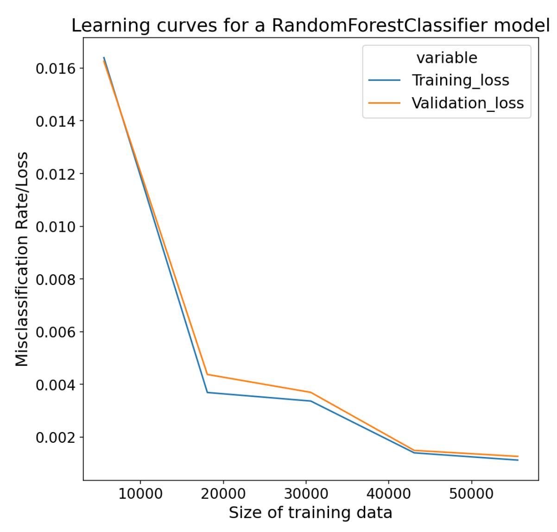
Results
Based on the f1 score and accuracy(0.965 and 0.96 respectively), the team decided to choose Random Forest Classifier for our use case.
Bias: 0.00233 Variance: 0.2488

Slide 10
Conclusion
The majority of the literature survey revolved around image based fire detection.
The model developed is a minimalistic one which doesn't need image processing and can work on IOT devices' data.
Overall, the model is well generalized with different data.
For the same reason, it can be deployed as edge deployment (TinyML on Aurdino Boards) and predict the alarms in real-time.

Slide 11
References
[1] A. Shamsoshoara, F. Afghah, A. Razi, L. Zheng, P. Z. Fulé, and E. Blasch, “Aerial imagery pile burn detection using Deep learning: The flame dataset,” Computer Networks, vol. 193, p. 108001, 2021.
[2] S. G. Kong, D. Jin, S. Li, and H. Kim, “Fast fire flame detection in surveillance video using logistic regression and temporal smoothing,” Fire Safety Journal, vol. 79, pp. 37–43, 2016.
[3] A. Khan, B. Hassan, S. Khan, R. Ahmed, and A. Abuassba, “DeepFire: A novel dataset and deep transfer learning benchmark for forest fire detection,” Mobile Information Systems, vol. 2022, pp. 1–14, 2022.
[4] W. Cai, C. Wang, H. Huang and T. Wang, "A Real-Time Smoke Detection Model Based on YOLO-SMOKE Algorithm," 2020 Cross Strait Radio Science & Wireless Technology Conference (CSRSWTC), 2020, pp. 1-3, doi: 10.1109/CSRSWTC50769.2020.9372453.

